Slide 1

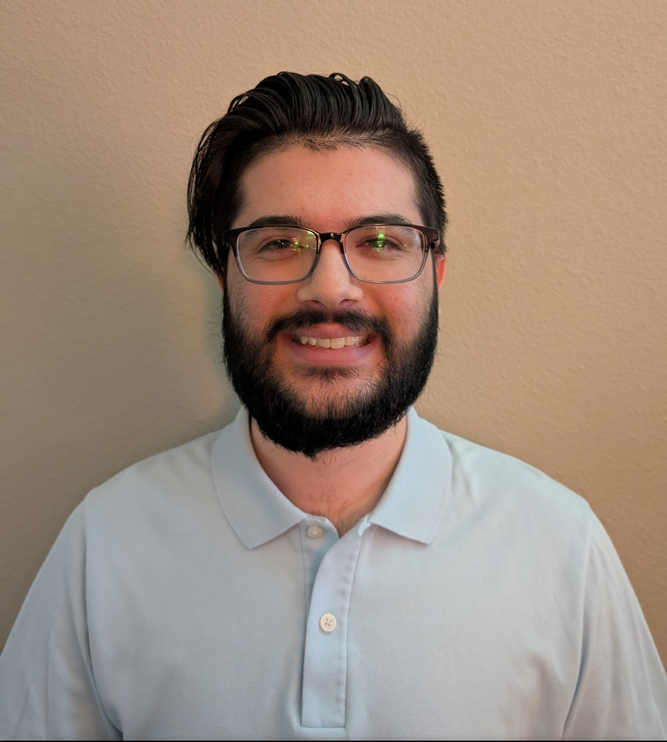
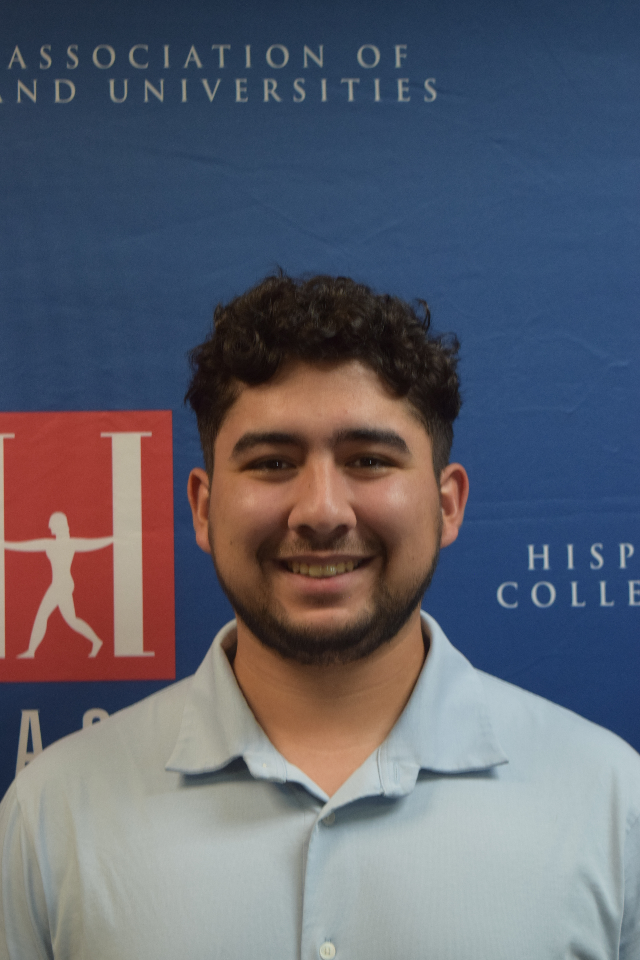
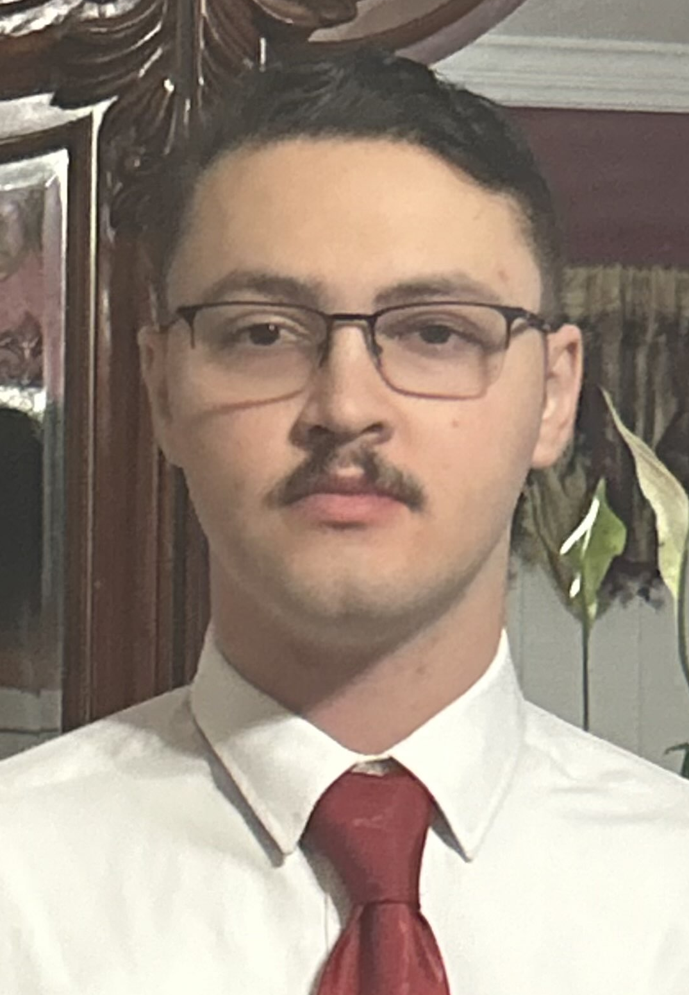
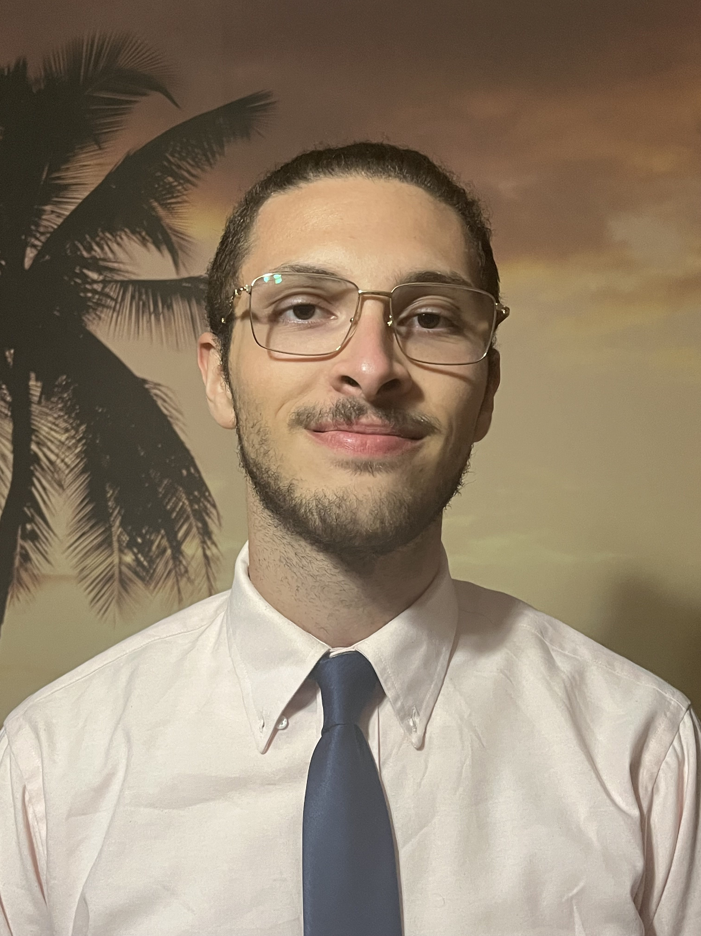

S.W.A.N-U.S.A
Smart water bottle for athletic nutrition liquid analysis using spectroscopy
Group 10:
Gonzalo
Gomez –Silva (EE)
Dominic Falvo (EE)
Farris Thrower (PSE)
Rhami Thrower (CS)

Slide 2
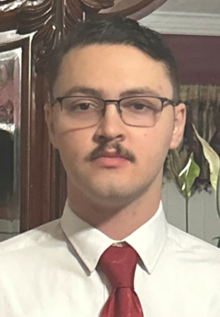
Motivation/Background
Motivation:
  Enhance user experience when tracking macros from beverage.
  Incorporate the use of metrology (optics) to provide something never seen in portable water bottles.
Background:
  Reusable water bottles are a staple to society in efforts to reduce waste.
  There are tons of “smart bottles on the market”, all of which use dual motion or ultrasonic sensor to tell the user how much they drink.

Slide 3

Goals
Goals:
  Basic Goal: Design a smart water bottle that can characterize beverages using spectroscopy and enhance user experience.
  Advanced Goal: Validate information provided on nutrition tables through measurements of food dye and/or sodium concentrations. Consider adding more hardware to improve consumer experience
  Stretch Goal: Broader spectrum to characterize more ingredients in the beverage. Improve battery life through reduction of power requirements and efficient run times.

Slide 4
Basic Objectives
Basic Objectives:
  Use ultrasonic sensor to accurately assess how much liquid an individual drinks.
  Incorporate a touch sensor to have an integrated sleep mode to improve battery life.
  MCU relay info reliably to mobile app via Bluetooth.
  Identify type of food dye through spectroscopy.(measure absorption)
  LED alert system to inform users on hydration and nutrition progress.

Slide 5
Advanced and Stretch Goals:
Advanced Objectives:
  Identify the concentration of food dye and/or sodium concentration in the beverage using beers law of absorption.
  Reduce the size of the spectrometer to fit on slimmer bottles.
  Research/ incorporate different sensing methods for better energy efficiency.
  Add second form of alert system like vibration technology or push notifications.
Stretch Objectives:
  Incorporate a xenon flash lamp or other UV source to enable more molecular group analysis.
  Add a bottle tracking system
  Research and add methods to extend battery life

Slide 6
Engineering Specifications
Product Requirements | Requirement Specification | Units
Battery Life needs to be reliable | ≥ 3 | Hours
Bottle weight should be easily handled | ≤ 2 | Pounds
Bluetooth to app response time should be smooth | ≤ 50 | milliseconds
Elapsed time for information update | <5 | seconds
Power efficiency of all components for better battery efficiency | ≥ 40 | percent
Accurate spectral analysis to assess liquid type | ≧ 80 | percent
Accurate ultrasonic sensor reading for beverage level | ≧ 80 | percent
High signal to noise ratio for adequate optical signal | SNR ≧ 40 | dB

Slide 7
Hardware Selection

Slide 8
Microcontroller Comparisons
Requirements
  Bluetooth
  UART and I2C communication
  Interrupts and sleep modes
  Cost
  Would like to use Arduino IDE to aid in programming.

Slide 9
Microcontroller Comparisons
Final Choice is the ESP-32-WROOM
  Plenty of GPIO pins if we needed more
  More than enough computing resources
  Dual Core Processor
  Operates at 3.3V
  Bonus of built in touch sensor
  One of the cheapest options
 | ESP-32 | Nano 33 BLE | MSP430 | Zero 2 W | Pico W | UNO R3
UART | Yes | Yes | Yes | Yes | Yes | Yes
I2C | Yes | Yes | Yes | Yes | Yes | Yes
SPI | Yes | Yes | Yes | Yes | Yes | Yes
Wi-Fi | Yes | Yes | No | Yes | Yes | No
Bluetooth | BLE V4.2 | BLE V5.0 | No | Yes | BLE | No
ADC | Yes | Yes | Yes | No | Yes | Yes
Capacitive Touch Sensor | Yes | No | Yes | No | No | No
Processing Cores | 2 | 1 | 1 | 4 | 2 | 1
Processor Clock Speed | 240MHz | 64 MHz | 16MHz | 1GHz | 133MHz | 16MHz
RAM | 520KB | 256 KB | 128KB | 512MB | 264KB | 2KB
Operating Voltage | 3.3 | 3.3 | 3.3 | 5 | 3.3 | 5
Price | $15 | $25.80 | $25 | $15 | $5 | $27.50

Slide 10
Touch Sensor Comparison
The ESP32 touch sensor gives the most customization.
Does not take up extra space.
No need to add code library.
 | ESP32 Touch Sensor | DIY Touch Sensor | TTP223 Capacitive Touch Sensor | AT42QT1010 Standalone Touch Sensor
Accuracy | High | Low | High | High
Cost | Included with MCU | $14 | $7 for 20 | $5.95
Space | Built-In | Designed into PCB | 14.5mm x 11mm | 20mm x 28mm
Power Draw | Apart of MCU | Unknown | 6µA at idle | 17µA on average at 1.8V
Touch Area Size | Customizable | Customizable | Not Customizable | Customizable
Documentation | Plenty | Adequate | Adequate | Plenty
Sensor Output | Serial | Serial | Digital High | Digital High

Slide 11
Water Level Sensor
To communicate with app on the status of the bottle a water level sensor is needed.
Requirements
  Work on 3.3v
  Water resistant or proof
  High accuracy
  Small Blind range
  Bottle Fitting

Slide 12
Ultrasonic Sensor Comparison
Our sensor technology of choice for determining the water level is the Ultrasonic sensor
Fitting all our requirements is the A02YYUW Sensor
Although the cost is the highest the waterproofing and great blindzone offsets that con
 | Voltage | Current | Range | Waterproof | Dimension | Cost
HC-SR04 | 5VDC | 15mA | 2cm-4m | No | 45*20*15mm | $5.00
A02YYUW | 3.3-5 VDC | 8mA | 3cm-450cm | yes | 84*29*12mm | $15.90
JSN-SR04T | 3.3 – 5 VDC | 8mA | 20cm-600cm | yes | 42*29*12mm | $13.00

Slide 13
Regulator Selection and Comparison
Linear Regulator technology is selected
  Simple 3 components required to function
  Not as susceptible to noise
  Should not affect battery life too much as our battery capacity is high (3500mAh)
 | Voltage | Efficiency | Simplicity (BOM cnt.) | Topology | Footprint | Cost
LM317L | 3.3VDC | 50% | 5 | Linear Regulator | 20mm^2 | $0.60
TPS61023 | 3.3-5 VDC | 90% | 7 | Boost Passthrough/ Boost | 102mm^2 | $0.73
TPS63021 | 3.3 VDC | 83.8% | 6 | Buck-Boost | 47mm^2 | $1.24
TPS61022 | 5VDC | 94.9% | 7 | Boost passthrough | 99 mm^2 | $1.08
TPS630252 | 3.3VDC | 92.2% | 5 | Buck-Boost | 93 mm^2 | $1.24
LM1117 | ADJ or Fixed at 3.3V and 5V | 60% | 3 | LDO/ Linear Regulator | 20mm^2 | $1.24

Slide 14

Battery Selection
For the portability of our water bottle the usage of batteries is required.
For safety in the lab the use of Li-ion batteries are the choice for the project.
The 18650 Li-ion Battery is the battery of choice
Most batteries on our table suit or design needs but are unprotected compared to the 35E from Samsung
 | Voltage | Discharge current | Capacity | Topology | Size | Cost
EEMB 103454 | 3.7V | 400mA | 2000mAh | LiPo | 8*56.5*60.5mm | $12.99
Mikroe MLP805660 | 3.7V | 600mA | 3000mAh | LiPo | 55*34.5*10mm | $17.40
LP675365JU | 3.7V | 600mA | 2800mAh | LiPo | 68*54*7.2mm | $17.80
LP906090JH | 3.7V | 1200mA | 6000mAh | LiPo | 93*60*9mm | $23.64
35E | 3.7V | 8000mA | 3500mAh | Li-ion | 18.42*66.92mm | $7.09

Slide 15
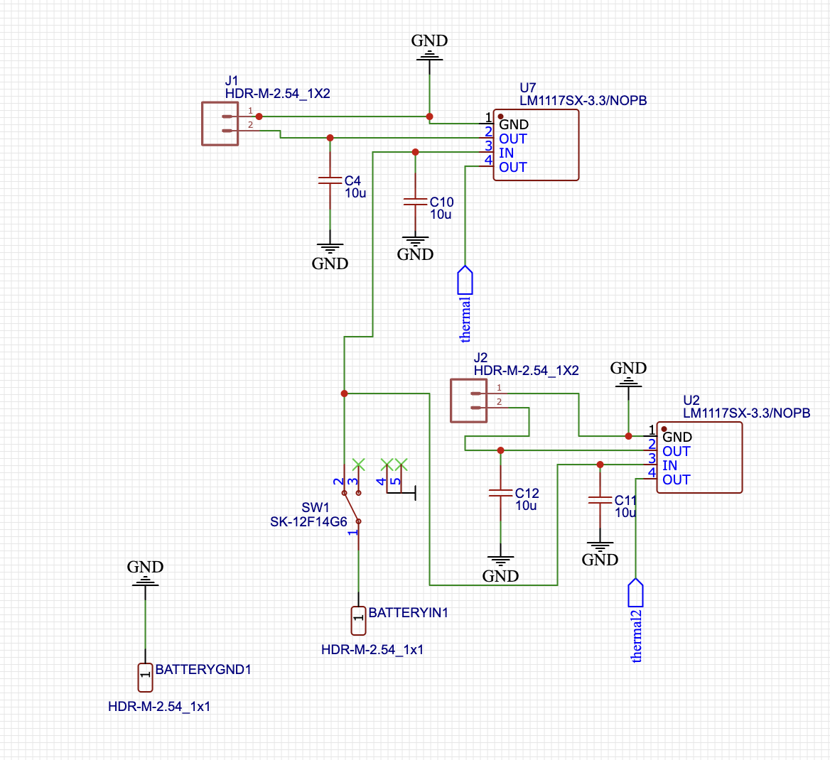
Power Supply – LM1117 LDO
2 35e Samsung Batteries in series for 7.4V nominal output
Linear Dropout Regulator that has a fixed output of 3.3V
2 LM1117’s to distribute load and thermal dissipation
Maximum current 800mA
Anticipated current draw – 300mAh full use

Slide 16
Optical Hardware Comparison
Light emitting Diode | Laser diode
Broadband light source | Narrowband Light source
Polychromatic | Monochromatic
Attenuation due to dispersion | Less attenuation
15mW optical power | 10 mW – 500 mW optical power
Cheapest option | Get what you pay for
Photodiode | Linear Photodiode Array | CMOS sensor
Small detection area | Long detection area | Large detection area
Cheap | Expensive | Cheap - Expensive
Easily integrated | Hard integration | Easy integration
.3 A/W response | .3 A/W response | Sensitivity dependent on wavelength
60dB (theoretical) | 100dB (theoretical) | 40dB (datasheet)

Slide 17
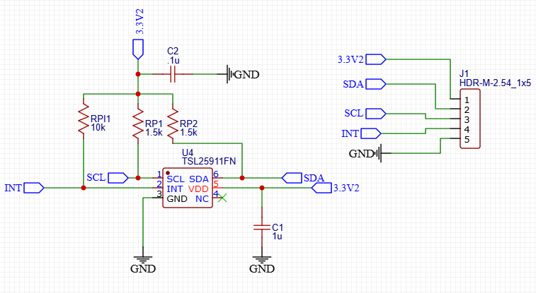
Optical Hardware Selection
Light sensor
Company | Product | Range(nm) | Active area (mm)² | Responsivity (A/W) | Price ($)
Thorlabs | FDS10x10 | 350-1100 | 100 | 0.725 | 220.95
Hamamatsu | S14833 | 340-1100 | N/A | 0.68 | N/A
Edmund Optics | #53-378 | N/A | 100 | 0.65 | 138.00
Adafruit | TSL2591 | 400-1100 | 56 | 0.6 | 6.95
ESP | OV2640 | 380-1100 | Adj. | 0.6 | 26
Light sensor selection
Covers spectral range
Small pixel size
Responsivity to visible wavelengths
Ease of integration
Must have i2c capability
price
Light source
Large spectral range
Efficient optical power
Small viewing angle
price
White LED Comparison
company | Product # | Wavelength range (nm) | Optical power (mW) | Viewing angle | Max DC forward current (mA) | Price
Thorlabs | LEDWE-15^{d} | 430 - 660 | 13 | 7.5 | 30 | 10.92
Thorlabs | LEDW7E | 430 - 660 | 15 | 7.5 | 30 | 8.76
Thorlabs | LEDW25E | 430 - 660 | 15 | 25 | 30 | 9.09

Slide 18
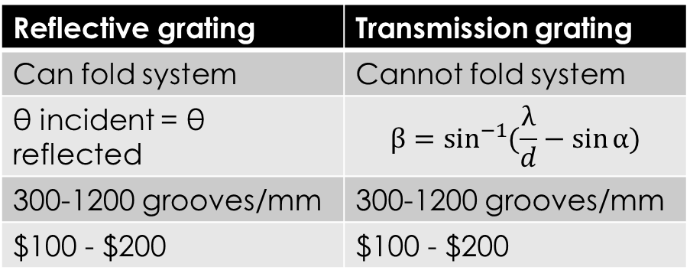
Optical Hardware Comparison
Lens vs.Mirror
Lens | Mirror
Any focal length | Any focal length
Transmission | reflection
30 - expensive | 50 - expensive
Reflective grating | Transmission grating
Can fold system | Cannot fold system
θ incident = θ reflected | $$β=\sin^{−1}{(\frac{λ}{d}−\sin{α)}}$$
300-1200 grooves/mm | 300-1200 grooves/mm
$100 - $200 | $100 - $200
Lenses and mirrors act similarly
Mirrors are not susceptible to chromatic aberration
Lenses focus light at different points depending on wavelength
The diffraction grating along with the slit size determines the spectral resolution of spectrometer. Industrial spectrometers usually have a spectral resolution of 1 nm.

Slide 19
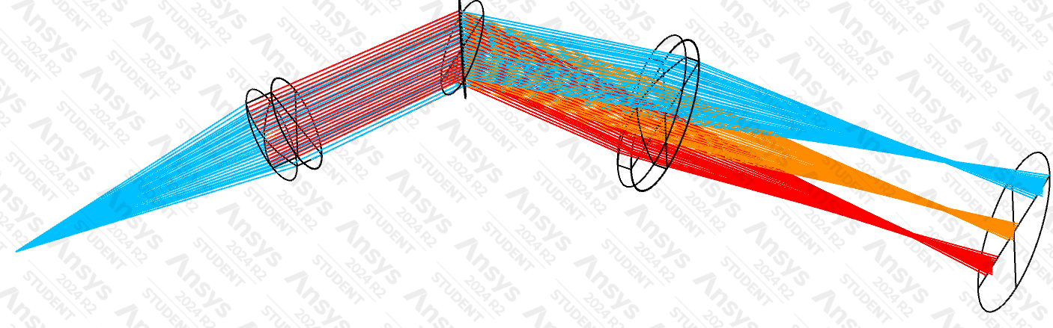

Optical Hardware Selection
Lenses
Company | Product # | Material / coating | F/# | NA | Diameter | Focal length | Price ($)
Thorlabs | LA1116 | N-BK7 /uncoated | N/A | 6 mm | 10 mm | 24.12
Thorlabs | LA1222 | N-BK7 /uncoated | N/A | 6 mm | 15 mm | 22.56
Newport | KBX031 | N-BK7 /uncoated | 3 |.16 | 12.7 mm | 38 mm | 37.00
Newport | KPX046 | N-BK7 /uncoated | 3 | .16 | 12.7 mm | 38 mm | 33.00
Edmund Optics | #37-801 | N-BK7 /uncoated | 1.57 | .32 | 12.7 mm | 20 mm | 29.00
Spectral resolution of system:
$$R=\frac{σ∗slit width}{W ∗fnumber}$$
$R=\frac{\left(0.6 µm\right) x (250 µm)}{12.7mm x 3}$ = 3.94 nm
Ruled Gratings
Company | Product # | Grooves/mm | Groove angle | Price
Thorlabs | GT13-06V | 600 | 28.7 | 90.87
Thorlabs | GT13-03 | 300 | 17.5 | 90.87
Edmund Optics | #49-575 | 300 | 17.5 | 102.00
Edmund Optics | #49-576 | 600 | 28.7 | 102.00

Slide 20
Summary of Hardware selection
Selected Hardware
Microcontroller | ESP32-WROOM
Battery | 35E Samsung 3500mAh
Ultrasonic sensor | A02YYUW
Touch sensor | Built in ESP32-WROOM
Notification LED | LED
Spectrometer LED | Thorlabs LEDW7E
Lenses | L1 Newport(KPX046) L2Newport(KBX031)
Diffraction Grating | Thorlabs GT13-06V
Light sensor | TSL2591 (or potentially osv2640)

Slide 21
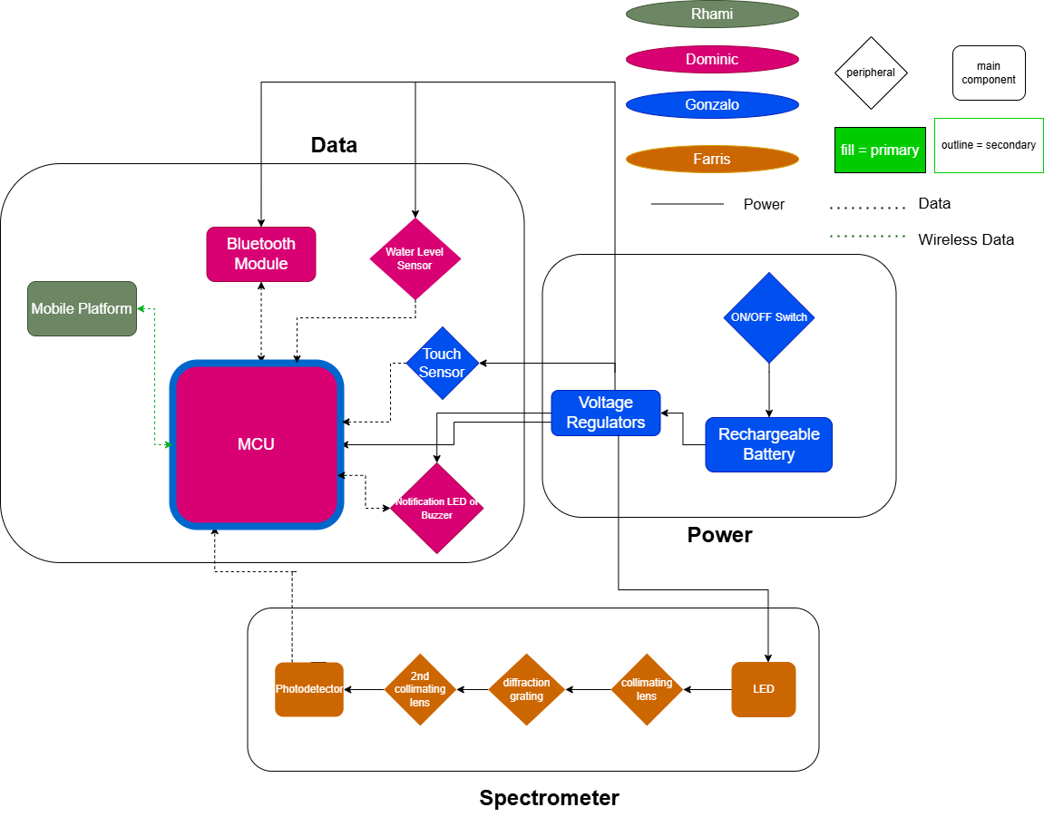




Hardware Block Diagram

Slide 22

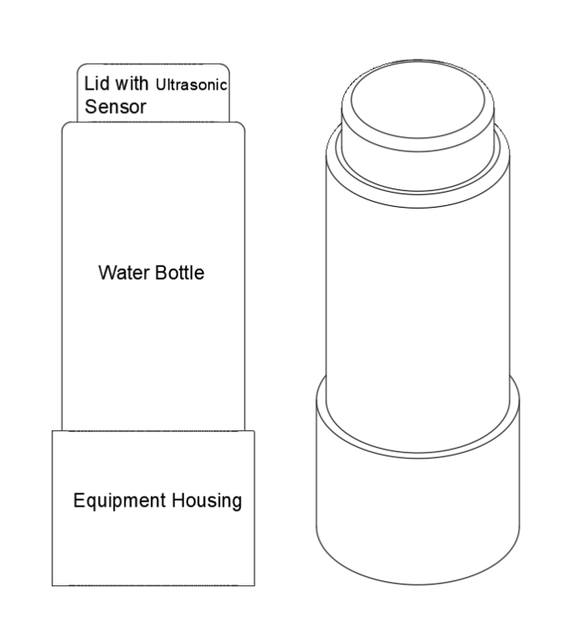
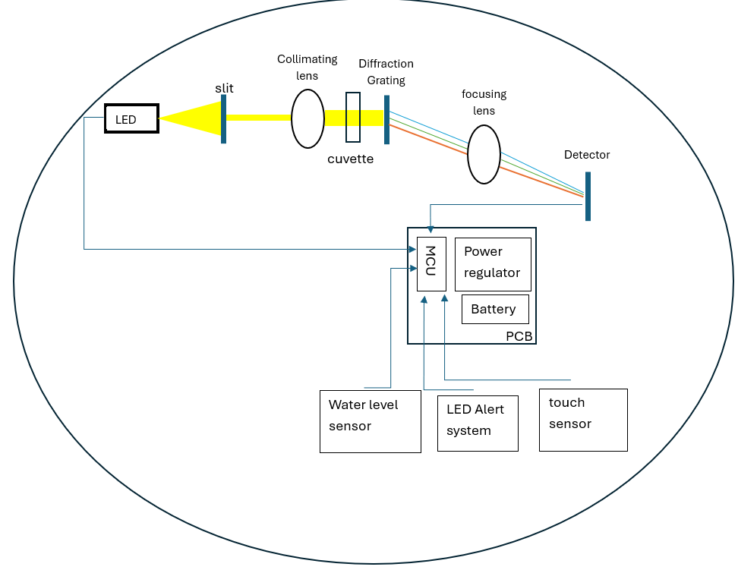
Schematic for the bottle

Slide 23
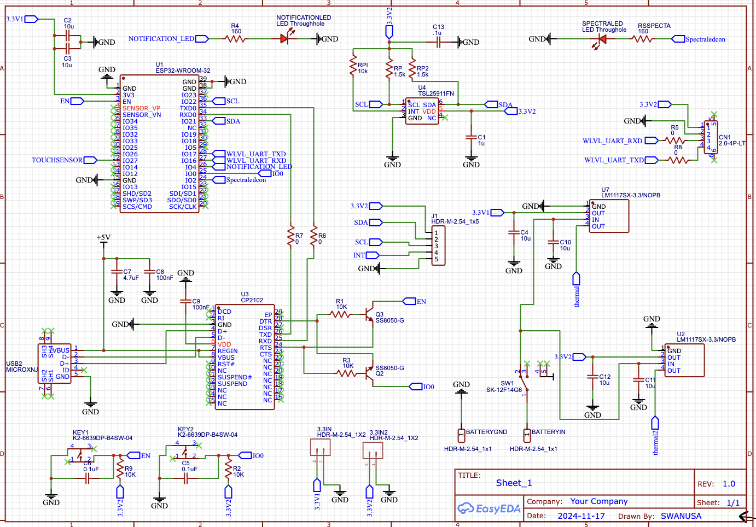
Hardware Design

Slide 24
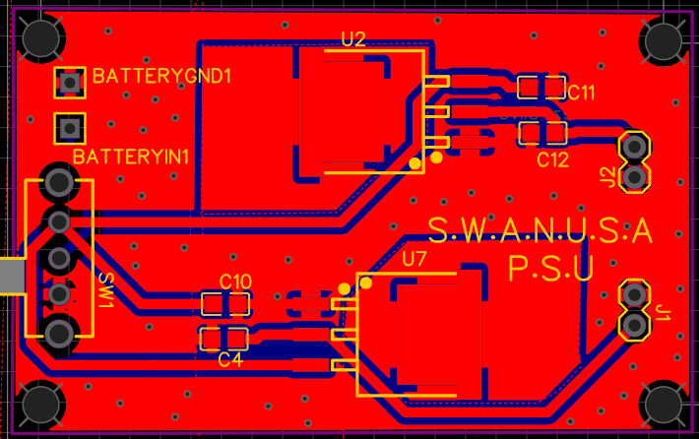
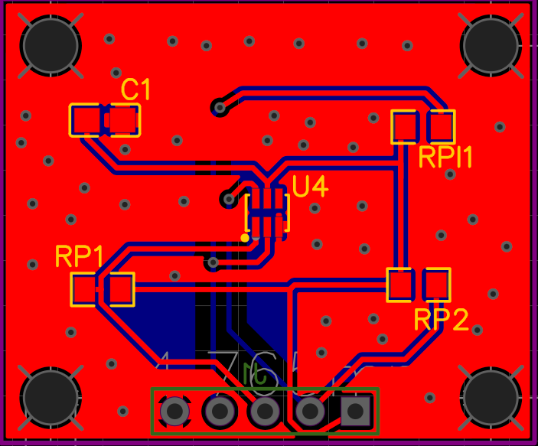
PCB Layout

Slide 25
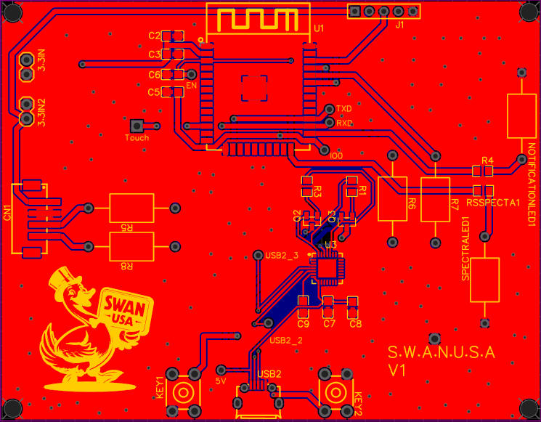
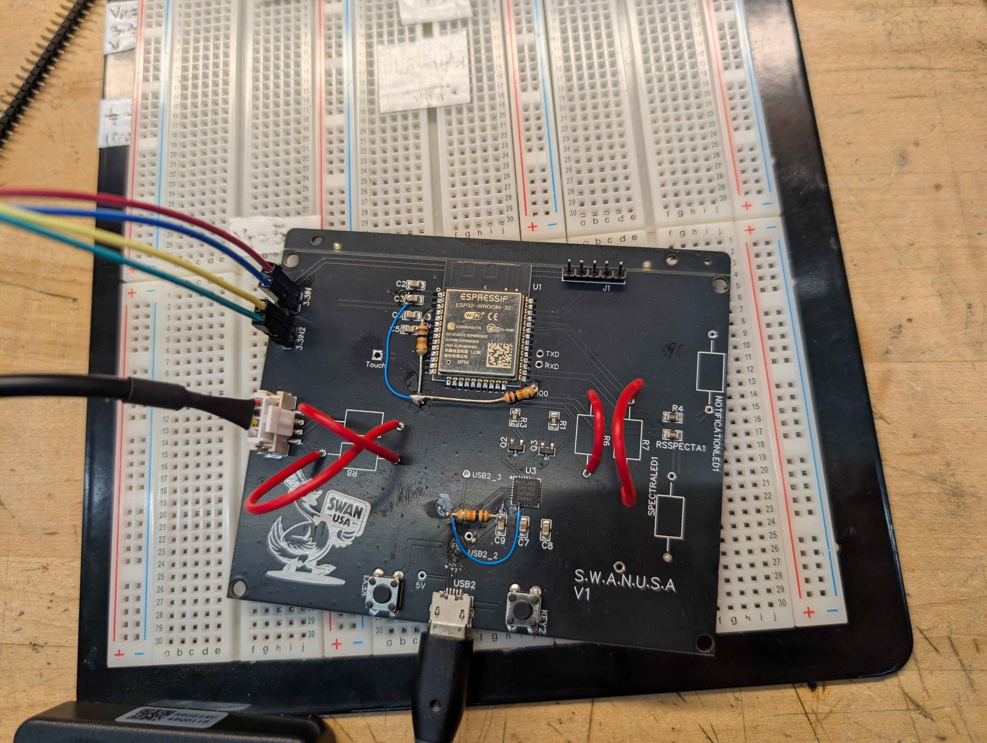
PCB Layout

Slide 26
Software Comparison
Two major Comparisions:
Mobile App (Front-end, Back-end)
Communications (bottle -> App & App -> server)

Slide 27
Front-end
What does the Front-end do?
Why are these factors important?
  Cross platform
  Language
  API's (android, iOS)
  UI/widget customization
 | Flutter | Kivy | React Native
Cross Platform | Y | Y | Y
Language | Dart | Python | JavaScript
Difficulty | High | Low | Medium-High
Runtime | Fast | Slow | Fast
Customization | High | Low | High

Slide 28
Back-end
What does the Back-end do?
Why are these factors important?
  Scalability
  locality
  Cost
  Functionality (base feature)
Other benefits
  Ease of use
  Testing
  Functionality (additional feature)
 | Firebase | AWS
Scalability | Vertical & horizontal | Vertical & horizontal
Locality | Many servers via Google | Many local servers
Cost | Low | Low
Databasing | Many Options | Many options
App deployment | Offered(hosting, storage, authentication) | Offered(hosting, storage, authentication)
App testing | Yes | Yes
Extra Features | Moderate extra features | Many extra features

Slide 29
Wireless Communications
Bottle to app
  Bluetooth vs.. Wi-Fi
  Real world applications
    Bluetooth usually straight forward for pairing, Wi-Fi not so much.
    Bluetooth being almost an industry standard for wireless communications
  Concerns?
    Security
    Re-Connectivity?
App to server

Slide 30
Software Selection
Front-end
  Flutter
    Customization
    Speed
Back-end
  AWS
    Extra Features
    Familiarity
Wireless communication
  Bluetooth
Back-end Extended
  AWS(Backend)
    Lamda
    DynamoDB
    S3
    Amplify

Slide 31
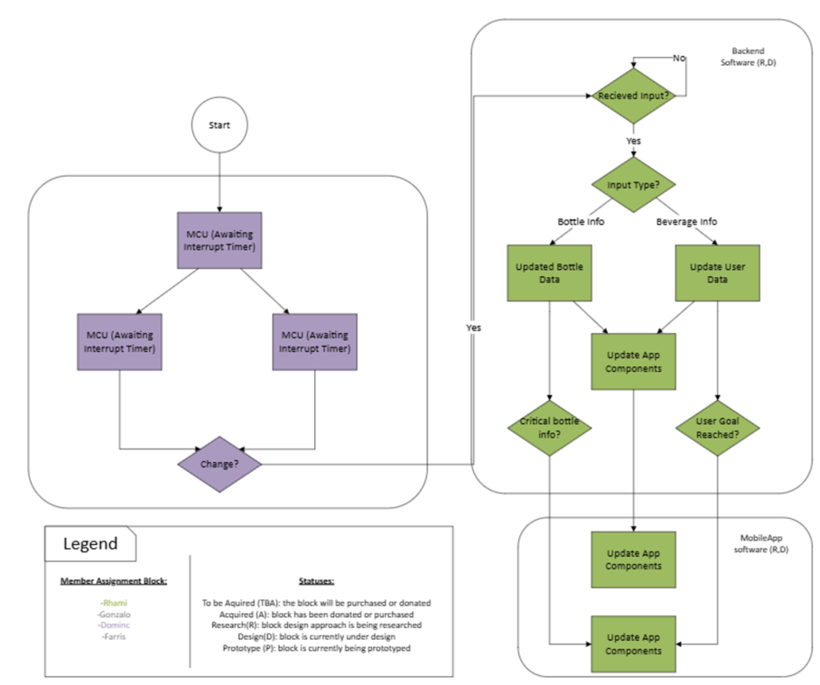
Software Design

Slide 32
User design and functionality

Slide 33
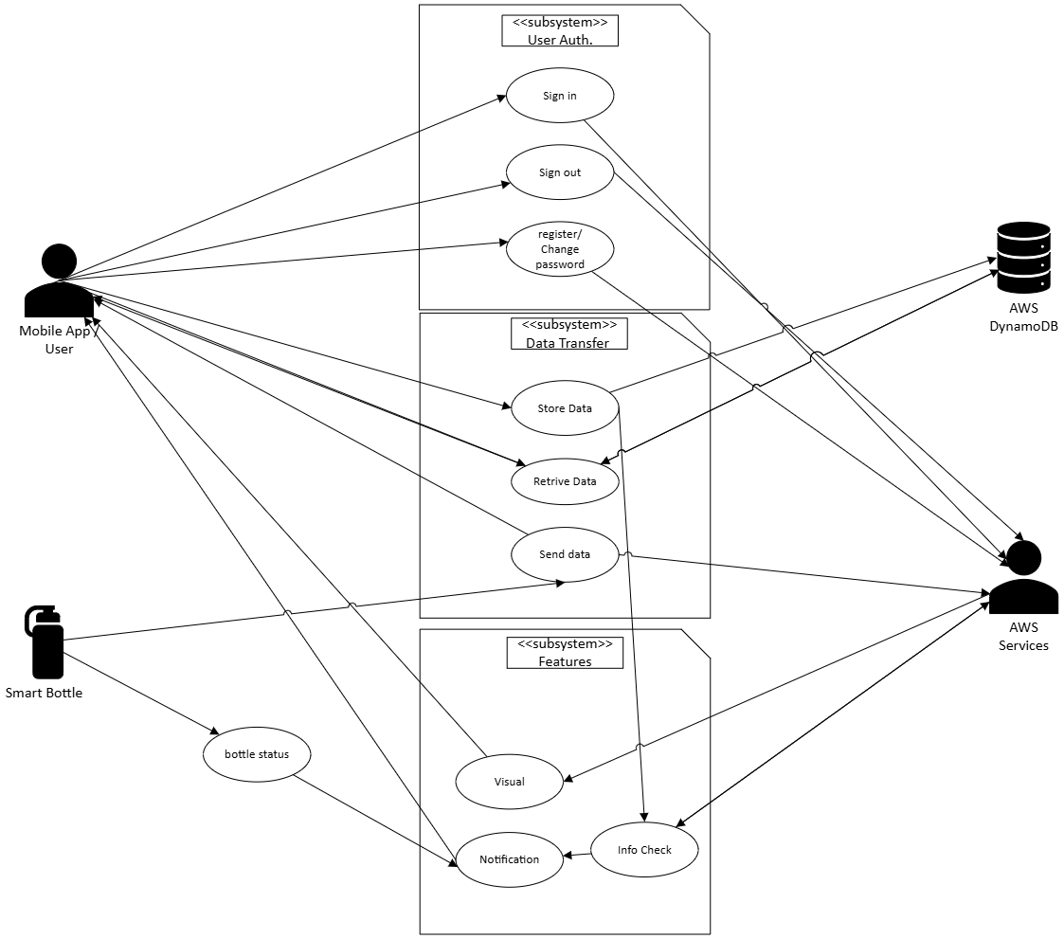
Use case Diagram
Four actors
  User (via mobile app)
  Bottle
  AWS DynamoDB( our database
  AWS services(other AWS services)
Three base features outlined
  User Authentication
  Data transfer
  Alt. featrues

Slide 34
Mobile app Design and functionality

Slide 35
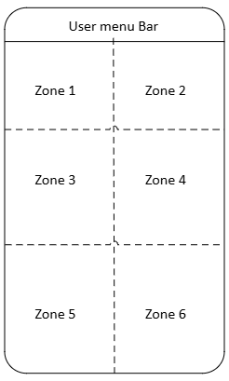
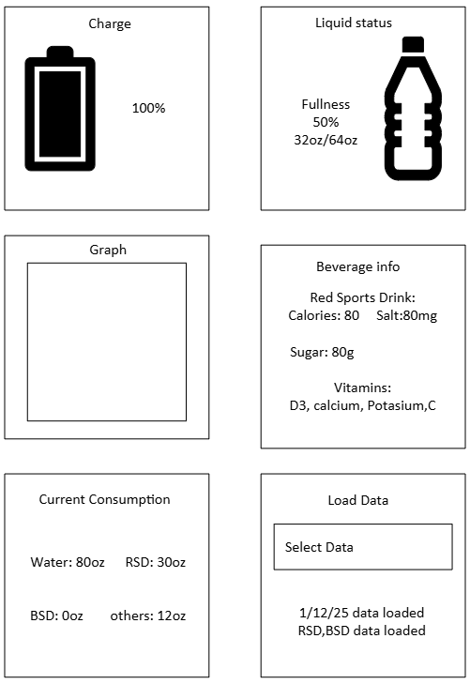
UI design
App design:
  Zones
    3-6 zones
  Widgets
    Bottle's battery
    Current beverage consumption
    Graph Data
    Beverage info
    Load data
    Realtime drink data

Slide 36
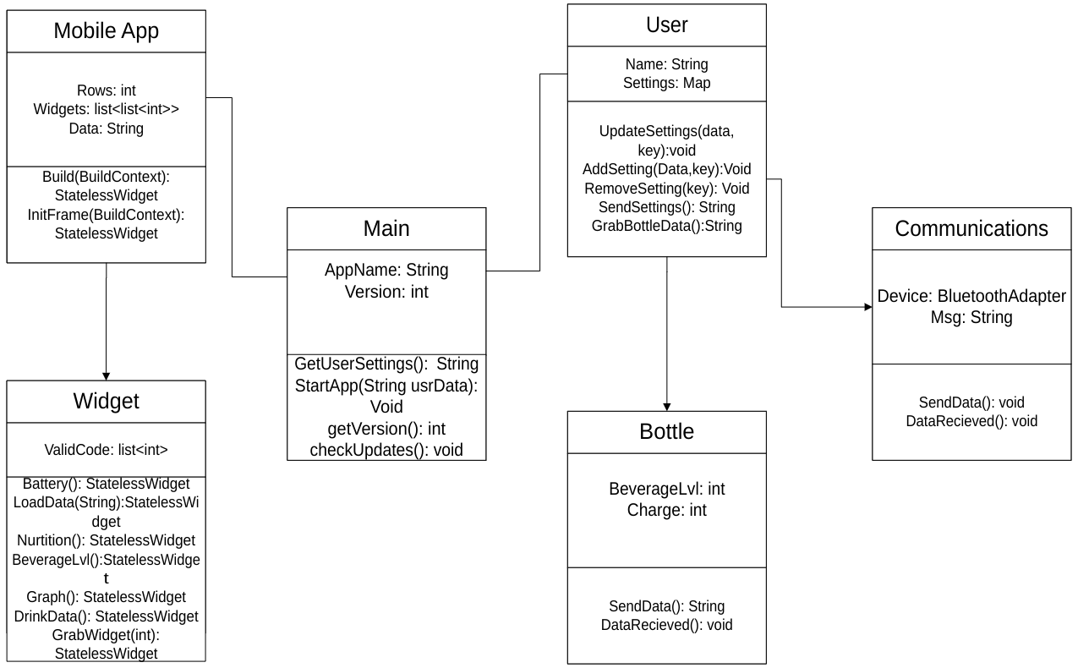
Class diagram
Used to help make code more readable
Breaks off mobile-App elements for potential user customization.
Makes debugging easier

Slide 37
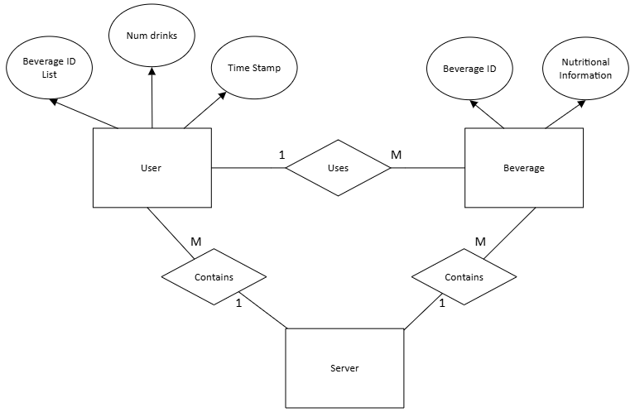
Database Design
Two distinct databases:
  One for beverage info
  One for user info
Partitioning:
  User
    Primary: user ID
    Secondary: beverage ID
  Beverage
    Beverage ID
Must be used in tandum!!!

Slide 38
Hardware Testing Plans
PCB and breakout board testing:
  Main board tested and working 1/21/25
  PSU board tested and working 1/14/25
Component testing:
  Battery testing 1/14/25
  Ultrasonic Sensor testing 1/14/25
  Touch sensor testing 1/21/25
Optical system testing:
  Optical system alignment and component housing testing 2/1/25
  Light sensor testing and preliminary spectrometer software testing (in progress)
  Absorption and concentration testing (begin 2/11/25)
  System integration and prototyping (begin 2/21/25)

Slide 39
Software Testing Plans
Base tests
  Deploy app/ deploy app update( includes download)
  Expected data update
  Expected widget update
  Change Graph view
  Login/out and register new user
Extra tests
  Try creating an existing user
  Try loading invalid data
  Trying loading and unloading widgets.
  Try loading data repeatedly

Slide 40

What is done
Front-end
  Basic UI
    Still needs some Connections and beatification
  Need to integrate backend components
Back-end
  Database and database functions
  Graph function (60%)
  Deployment(80%)[need to add node.js & test]

Slide 41
What isn't going well
Back-end deployment
  Unsure on how to implement the node.js to the project to deploy the app
The Graph function
  Taking longer than expected
  Can't get the graph to be as dynamic as I would like
Wireless communications
  Unsure on how to do the pairing process

Slide 42
Budget
Component | Subsystem | Quantity | Cost
Electrical
ESP32 Dev Kit | ALL | 1 | $15
Battery | PSU | 2 | $24.80
Ultrasonic Sensor | Water Level | 1 | $30.86
LED | Notification | 1 | $1.80
PCB Components
PCB | ALL | 1 | $145
3.3V Voltage Regulator | PSU | 2 | $1.48
CP2102 UART-USB Bridge | MCU | 1 | $3.53
ESP32-WROOM-32 Chip | MCU | 1 | $4.23
USB Micro Female | MCU | 1 | $0.34
JST 2.0 4 pin | Water Level | 1 | $0.45
MISC (Capacitors and resistors) | PCB | 1 | $8
Notes:
Project total is ~$500

Slide 43
Budget
Hardware
Battery Holder | PSU | 1 | $18
Bottle | ALL | 1 | $20
Heatsinks | PSU | 1 | $12.77
Spectrometer Components
LED | Spectrometer | 1 | $8.97
Collimating/ focusing Lenses | Spectrometer | 1-2 | $30 each
Diffraction grating | Spectrometer | 1 | $113.31
Photodetector | Spectrometer | 1 | $6.59
Sample vial (cuvette) | Spectrometer | 1 | $9.51
Notes:
Project total is ~$500

Slide 44
Work Distribution
Electrical Engineer | Main Responsibilities
Dominic Falvo | MCU Selection and Programming Touch Sensor Selection and Design Secondary PCB Designer Project Lead
Gonzalo Gomez-Silva | PSU Selection and Design Primary PCB designer Secondary MCU Programmer Notification LED Design
Computer Science | Main Responsibilities
Rhami Thrower | Front-End Software Design Back-End Software Design Server setup Database setup
Optics Engineer | Main Responsibilities
Farris Thrower | Spectrometer Component Selection and Design Co-Project Lead

Slide 45
Progress report

